Slide 1
Securing SSH Access
Pavel Shukhman, OWASP Meetup Ottawa, August 2019

Slide 2

Attack Vectors
Brute-force attacks
SSH traffic intercepts (MITM)
Attacks on administrator workstations
Insider attacks
Photo by Olga Levshina

Slide 3
Part 1. brute-force Attacks

Slide 4

Brute Force Today
Millions of daily brute-force attacks on a large honeypot built by UIUC (2017-2018)
Bots increasingly try keys
Chalubo IoT Botnet (September 2018)
Photo by Markus Spiske on Unsplash

Slide 5
Protect from Brute Force - I
Disable password authentication
Disable root user access
White-list user logins that may access SSH
Use non-standard port, i.e. 5xxxx instead of 22

Slide 6
Protect from Brute Force - II
Limit the source IP range
Use 2FA on SSH, i.e. with Google-Authenticator
Just-in-time access configured on Provider
Add monitoring on auth.log

Slide 7
Protect from Brute Force - Tools
SSHGuard (default on GCP images)
Fail2ban (protects SSH and other services)
DenyHosts

Slide 8
Part 2. man-in-the-middle

Slide 9

MITM Vulnerabilities
SSH v1 was proven vulnerable in late 90-s
Theoretical vulnerability with CBC ciphers in November 2008
Timing attacks
Snowden leaked information about NSA breaking SSH (Dec 2014)
Photo by Samuel Zeller on Unsplash

Slide 10
MITM Mitigation
Update Ciphers block in sshd_config to only include strong ciphers (AES, ChaCha20)
Require only strong ciphers on clients
How to manage host keys?

Slide 11
Bastion-style Infrastructure
Idea: only allow external SSH on Bastion nodes
SSH to production nodes only done through Bastions
Mitigation of MITM honeypot because it is hard to replicate
Mitigates other attacks on infrastructure

Slide 12



Bastion Architecture
VPC
SSH
Bastions
SSH
Application Nodes (only private IPs)

Slide 13
Signed SSH Certificates
HashiCorp Vault provides an open source solution
CA for signing public keys
Additional layer of security with host key signing
A PAM solution, but super-admin can circumvent

Slide 14
Part 3. Admin workstation

Slide 15
Suppose, laptop is broken into…
What can an attacker get?
Private keys?
Host IPs?
Host public keys?
Cloud Service Provider tokens?

Slide 16
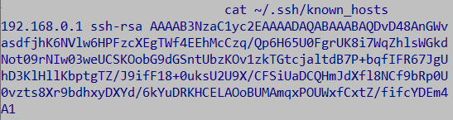
Known Hosts, Remote IPs, Host Keys
Add HashKnownHosts yes to ssh_config on client
Did not find an alternative on Windows
Essentially, remote IPs are hard to protect
cat ~/.ssh/known_hosts

Slide 17
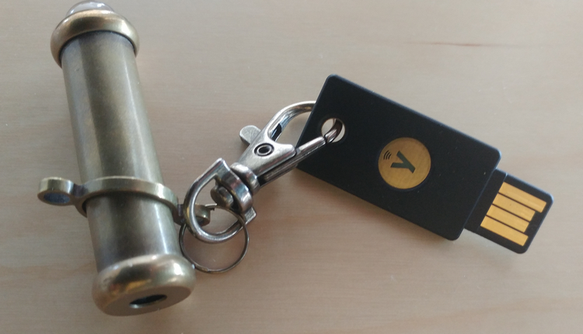
Where do you store private keys?
Your Laptop (Better: secured location on laptop)
USB key (Better: encrypted)
SmartCard (i.e. YubiKey)
Worst: When people start moving private keys around

Slide 18
Using YubiKeys
Best option security-wise
But: non-user-friendly configuration
Have to use PGP instead of standard SSH keys
Need at least 2 keys per person
Must generate keys on the card and back up cert

Slide 19
Authentication Strategies
Keep organization-wide inventory of public keys with rotation and scanners
LDAP / Kerberos
Signed certificates (HashiCorp Vault style)

Slide 20
Cloud Provider Access
Require MFA for Cloud Provider access
Try not to store access tokens on laptop
General hygiene: encrypted disks, secured access to OS, lock laptop when away, etc

Slide 21
Part 4. insider attacks

Slide 22
HR Considerations
Limit the number of SSH admins to minimum
Select most trusted people for the job (i.e., >2 years on the job)
Regular, at least bi-weekly, one-on-ones
Keep staff happy and motivated
Establish proper offboarding process

Slide 23
IAM, PIM, PAM
Mainly commercial tools in the space
May proxy SSH connections
May record SSH sessions
But questions remain

Slide 24
Remaining Questions on PIM, PAM
“You have to trust someone” (CS101)
Chicken-and-egg problem
What about PIM/PAM vendors?
Video recording of sessions not enough to prevent attacks (like street cameras)

Slide 25
Other Options
Minimize number of times when SSH access is needed
Shamir’s Secret Sharing principle and separation of concerns – a path forward
Open Source Solution – HashiCorp Vault
Recommendations solve many issues, but unable to mitigate all insider attacks

Slide 26
References
https://www.usenix.org/system/files/nsdi19-cao.pdf
https://en.wikipedia.org/wiki/Secure_Shell#Vulnerabilities
https://www.vaultproject.io/docs/secrets/ssh/signed-ssh-certificates.html
https://worklifenotes.com/2019/07/05/yubikey-for-ssh-on-windows-complete-walkthrough/
https://www.engineerbetter.com/blog/yubikey-ssh/
https://www.youtube.com/watch?v=exjorJyddok

Slide 27

About me, Pavel Shukhman
Working with Infrastructure, DevOps, DevSecOps, DataOps for more than 10 years
In the early stage of building Reliza, my 3rd self-founded Start-Up, and 5th total
https://www.linkedin.com/in/pshukhman

Slide 28
Thank you!

